Slide 1

Manhattan Community Board 10
Josue Enriquez
Josue.Enriquez@maill.citytech.cuny.edu

Slide 2
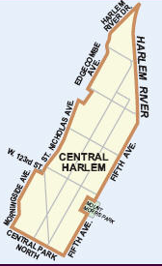
Community Board 10
District Manager
Andrew Lassalle, alassalle@cb.nyc.gov
Chair: Henrietta Lyle
6:00PM GENERAL BOARD 163 West 125th Street, 2nd Floor Art Gallery

Slide 3

Community Board 10 Website
Pros | Cons
Information is presentable | Missing Office Hours
Printer Friendly page | More social media
NYC Resources | Map out of local range
Meetings \Calendar | Search box give global search
Complaints\Tickets summit
Active Social Media

Slide 4


Community Board 10 Social Media
Active December 3 2015
Active December 3 2015

Slide 5
Initial Assumptions.
I think I will be seeing allot complaints about noises with loud music fall season
I think I will be seeing complains about garbage and sanitation on winter season
I think I will be seeing complains about street condition on spring season.
I think I will be seeing complains about Graffiti on summer season.
I think I will be seeing complains about Rat Sighting on winter season.

Slide 6
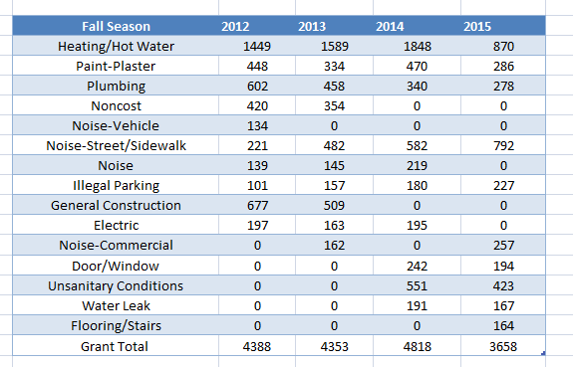
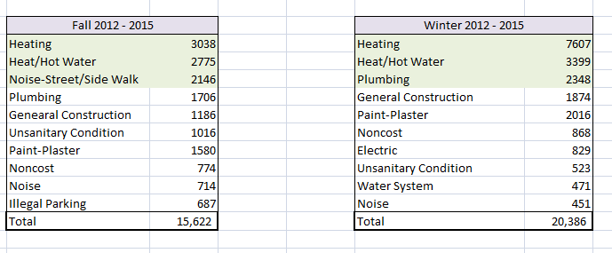

Slide 7
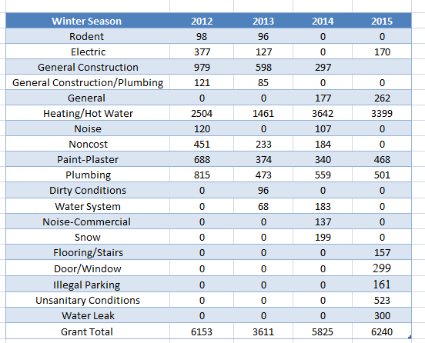

Slide 8
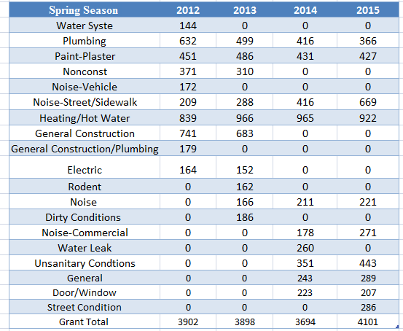
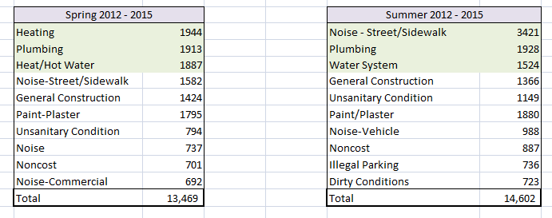

Slide 9
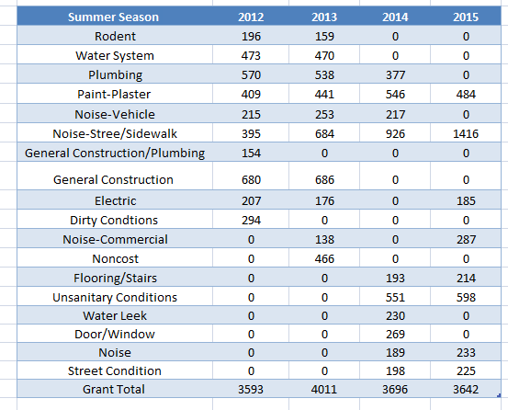

Slide 10
